Slide 1
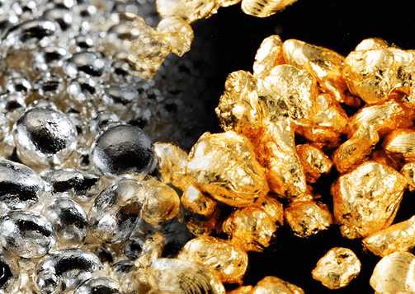
Unique Investment Opportunity
Gold Burning and Mercury Condensate (G+M) Device Project

Slide 2
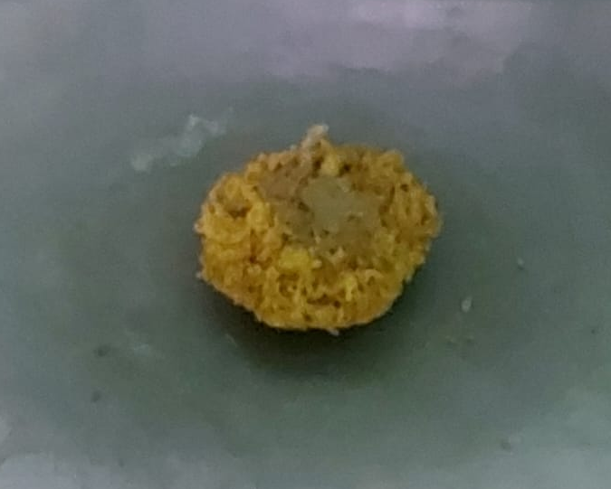
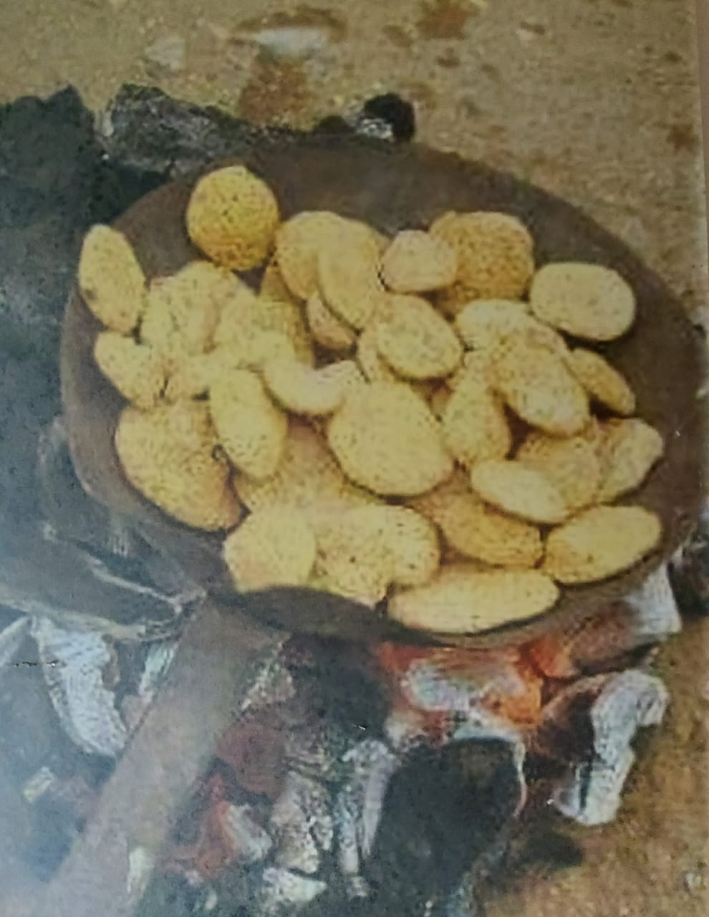
Gold exists in two forms
10% is found in a pure form on the surface and is easy to extract and collect
90% is extracted from mines in an impure form and must be filtered

Slide 3
Problem Statement

Slide 4

Burning gold the old-fashioned way causes
Deadly environmental pollution on the area of 36 countries
Losing quantities of gold while burning it
Loss of all amounts of burned mercury, which is equal to three times the amount of weight of gold produced

Slide 5

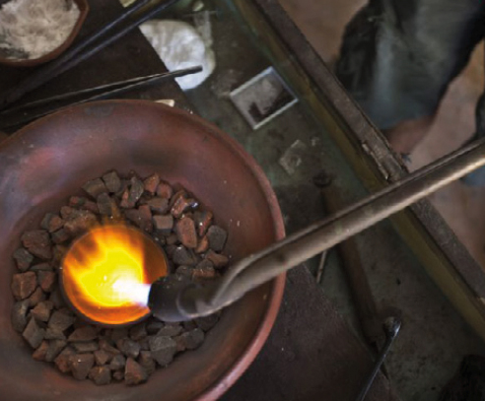
To purify the 90% of gold extracted from ground goes through three stages:
Grinding stone rich in gold atoms
Add mercury during grinding to catch gold atoms
Burn the mixture to get rid of mercury and get pure gold

Slide 6
Health & economic risks of burning gold the traditional way
Water Pollution: Gold mining contaminates water sources with mercury and cyanide, posing risks to people and ecosystems.
Air Pollution: The process releases hundreds of tons of airborne mercury each year, harming air quality.
Chemical Reactions: Exposing deep earth to air and water results in chemical reactions that produce sulfuric acid, which can seep into drainage systems.
Human Health Risks: Exposure to mercury vapors causes serious health issues affecting the nervous, digestive, and immune systems, as well as the lungs and kidneys.
Economic Risks: Annual mercury loss exceeding 300 tons in Sudan alone.

Slide 7
Market Opportunity

Slide 8
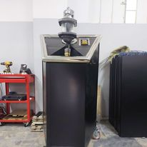
G+M device is a promising innovative idea that provides environmental, economic and technical solutions to more than 250 mining markets spread in more than 36 countries around the world.

Slide 9
Traditional mining markets
Traditional mining markets are spread in many countries of the world such as Indonesia, countries from South America and 22 countries in Africa.
Industry Overview: African countries are most contributors to global gold production
Economic Impact: Significant job creation and economic growth
Innovation Potential: Opportunities for safer and more efficient mining technologies

Slide 10
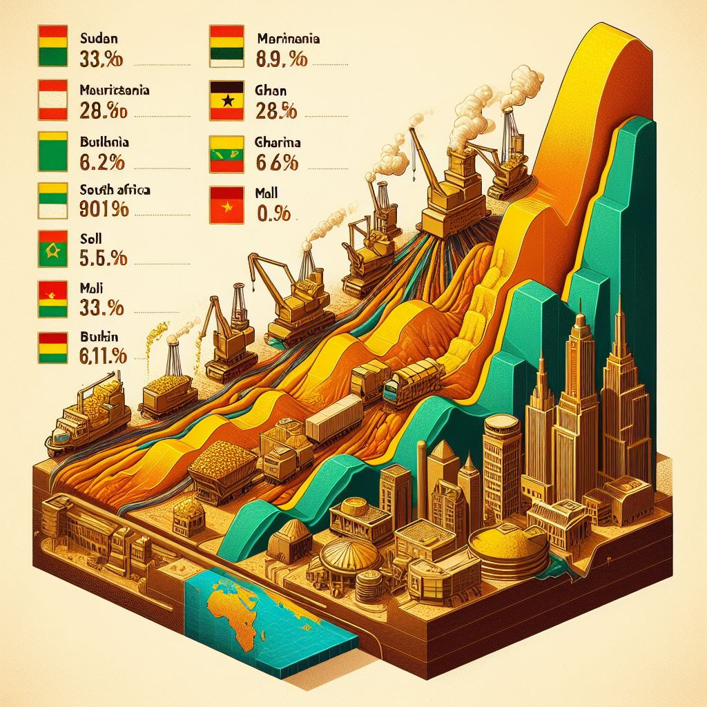
The contribution of the gold to the global market annually
Sudan: 41,800 kilograms (41.8 metric tons).
Mauritania:19,300 kilograms (19.3 metric tons) in 2022.
Ghana: 90,000 kilograms (90 metric tons) in 2022.
South Africa: 110,000 kilograms (110 metric tons) in 2023.
Mali: 93,800 kilograms (93.8 tons) in 2021.
Burkina Faso: 93,400 kilograms (93.4 tons) in 2021.

Slide 11

Job creation
Sudan: Over 1 million people.
Mauritania: Employs 9,165 people
Ghana: Around 1 million people.
South Africa: Approximately 93,800 people.
Mali: Around 200,000 people.
Burkina Faso: About 1.2 million people.

Slide 12
Our innovative solutions for traditional mining sector are environmentally friendly safe and efficient

Slide 13
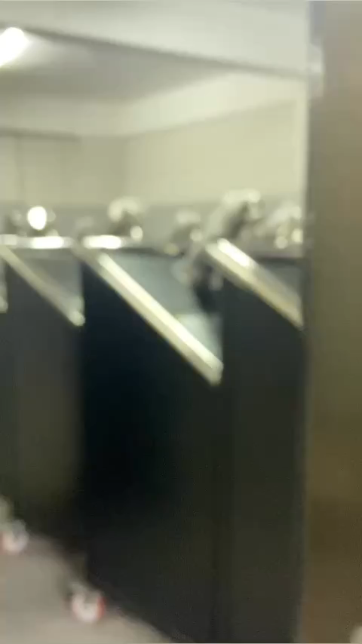

Slide 14
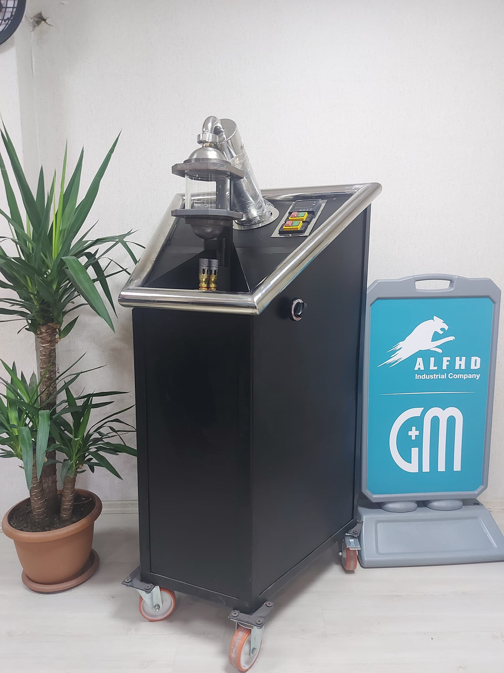
Introducing the Gold Burning and Mercury Condensation (G+M) Device
Key Features:
Complete gold extraction
Mercury condensation and recycling
Safe, closed glass chamber burning
Technical Specifications:
Dimensions: 160 cm x 90 cm x 90 cm
Weight: 140 kg
Power: Single phase 2.2 kW
Capacity: 1 gram to 1 kilogram per burn
Production Capability: Operates 24/7
Requirements: Only needs water, electricity, and gas
Ease of Use: Can be operated by anyone

Slide 15
Why Choose
Our Device?

Slide 16
Environmental protection and public health: It provides protection for all components of the environment (air, water and food) and the wealth of fish-animal countries from the dangers of the spread of toxic mercury vapor.
Increasing gold production: Burning gold by condensing device ensures the production of larger quantities of burning in the traditional way currently used (burning with coal and by (0.1 - 0.3) grams in each burning process and increases with the increase of the quantities burned because it uses closed burning, which prevents the volatilization of any amount of gold during the burning process
Control of the gold market: because it increases the production of gold accepted by miners to burn their amalgam, the greater the rate of spread of devices, the greater the opportunities for comfortable trade in raw gold to control it.
Control of the mercury market: The device ensures the recovery of large quantities of burned mercury compared to the old method and is resold in the mining markets at a price of $ 200 per kilogram and can be used thousands of times.

Slide 17
Unique Selling Points
Worker Safety:
Eliminates health risks from mercury exposure
Economic Benefits:
Fast ROI within two months, significant monthly profits
Environmental Protection: Reduces mercury pollution
Efficiency:
Faster and more complete gold extraction process
Innovative Concept:
Device is based on a new and previously unused idea.
Gold Preservation:
Device helps miners retain their gold without loss during the burning process.

Slide 18
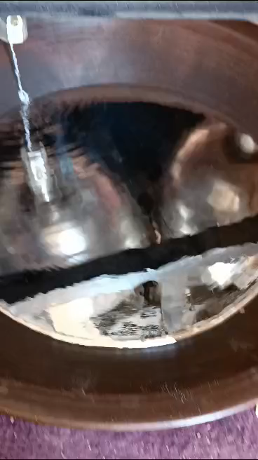
Mercury can be recovered in a 100% pure liquid state that can be used over and over again

Slide 19

Internationally patented
G+M device holds an international patent no:
PCT/SD2020/000003

Slide 20
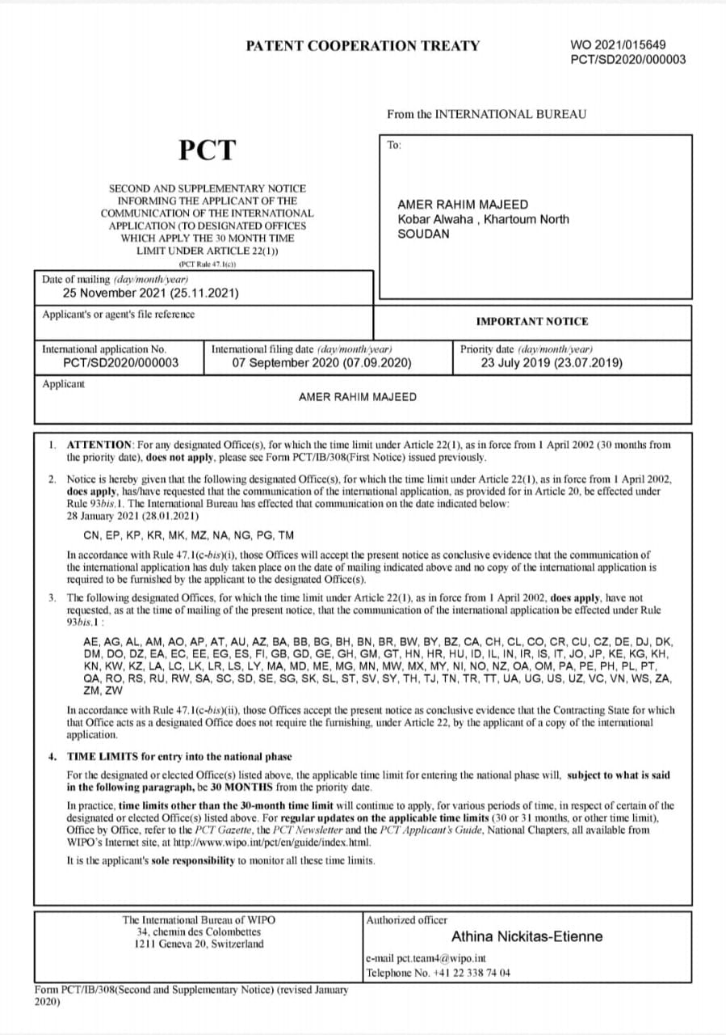
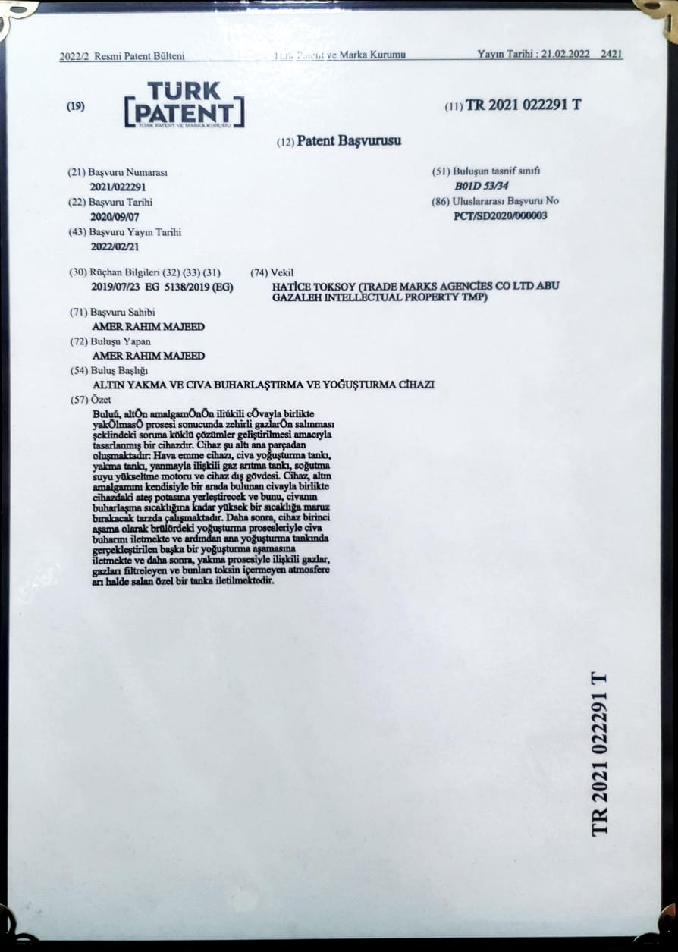
Copy of international patent / Geneva and Turkish patent

Slide 21
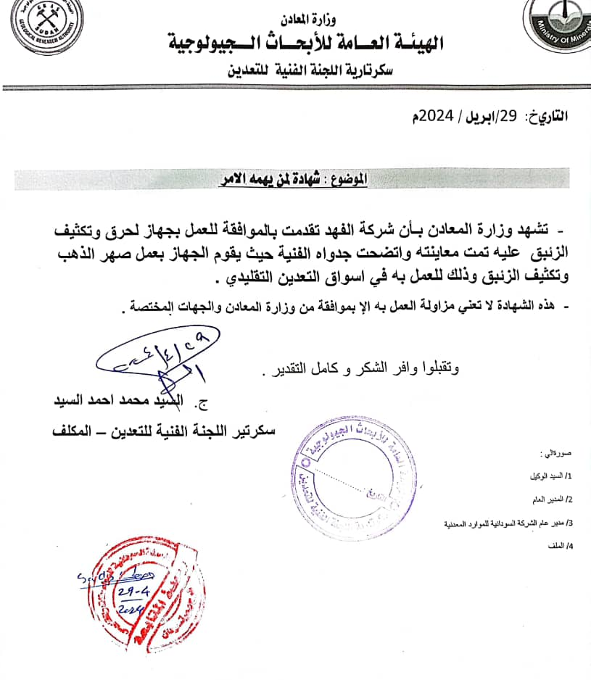
Certificate from the Ministry of Minerals in Sudan
The project is welcomed by the governments of countries that have permitted traditional mining on their lands, as it provides a safe environment free from harmful mercury vapor pollution.

Slide 22

Financial Projections

Slide 23
Financial Projections and ROI
Financial profits
[exceptional - easy - fast]
Recovering the capital within a period not exceeding two months
Daily and feasible profits of more than $ 200 per day at least

Slide 24
Financial Projections and ROI
Device Cost:
$6500
Monthly Profits:
$2000 - $4000
ROI Timeline:
Within 2 months
Long-Term Benefits:
Continuous pure profit generation

Slide 25
Market Strategy
Target Markets:
More than 250 markets spread in more than 36 around the world
Marketing Strategy: Highlight safety & economic benefits
Sales Strategy:
Direct sales & partnerships with local mining companies
Customer Acquisition: Demonstrations, workshop, promotional campaigns

Slide 26
Customer Benefits
Increased Gold Purity: Higher market value for gold
Environmental Impact:
Reduced pollution
Healthier Conditions: Safer working environment
Cost Savings:
Reduced need for coal and mercury

Slide 27

Customer Positive Feedback

Slide 28
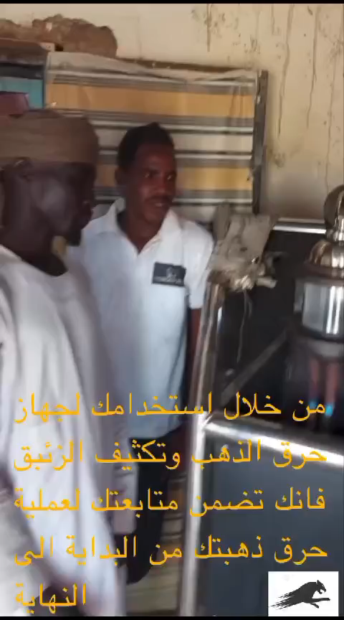

Slide 29

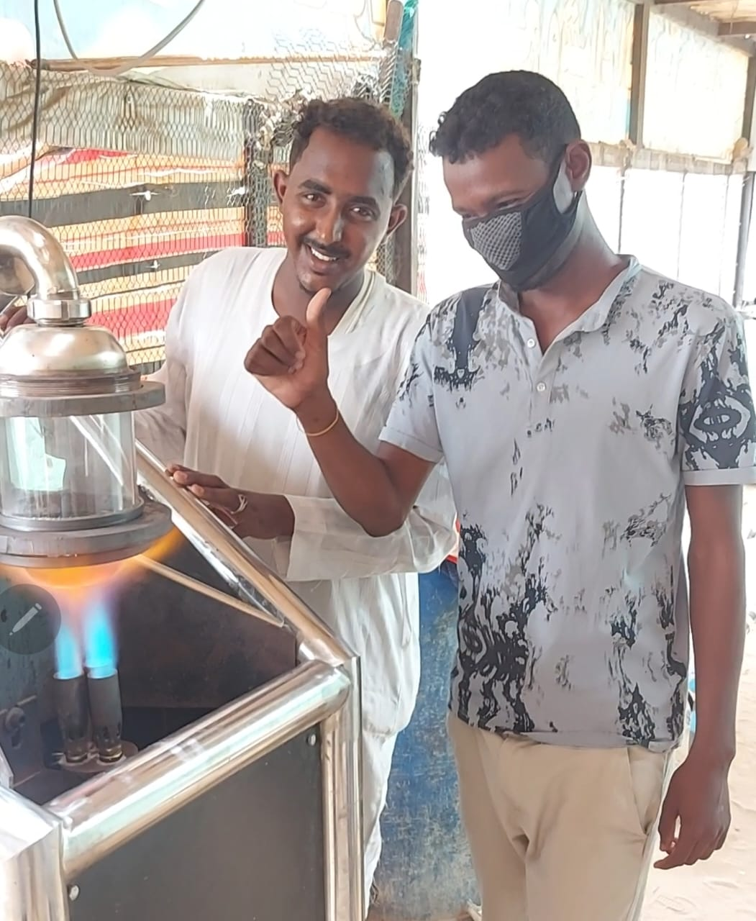


Slide 30

Investment Opportunity
Required Investment: $150,000
Use of Funds: Production, marketing, and distribution
Equity Offered: 50% shares
Expected Returns: Detailed financial projections

Slide 31
Advantages of investing in this project

Slide 32
Exceptional Profits: The project offers extraordinary returns, allowing for the recovery of capital in a record time.
Innovative Technology: Utilizes entirely new technology in mining markets, protected by an international patent.
Scalability: The project can be replicated and applied in various contexts.
Wide Approval: It has been well-received by all segments of those interested in the mining field.
Proven Implementation: The project is already operational in the largest traditional mining markets in a country renowned for its traditional gold mining.
Flexibility and Opportunity: The project has the capability to maneuver and seize valuable opportunities by relocating to the most productive mining markets within a single day, ensuring continuous profit growth and avoiding periods of stagnation.
Government Support: Local governments welcome the project due to its significant positive impact on environmental safety and security, achieved in a short period.

Slide 33

Call to Action
Amer Raheem Majeed
Al-Fahd Mechanical Industries for Integrated Solutions
Contact Information
Mobile: +90 536 368 2557 / +249 129 666 098
Email: alfahdgmm@gmail.com
Website: www.alfhdgm.com

